Slide 1
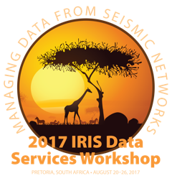
An Overview of IRIS and IRIS Data Services
TIM AHERN, DIRECTOR, IRIS DATA SERVICES

Slide 2
IRIS
facilitates seismological research
Installs and operates the infrastructure needed by earth scientists to understand the complex Earth.
Supports facilities in permanent networks, portable networks and data management services.

Slide 3
Overview: What is IRIS?
Consortium of 125 US Universities and ~125 foreign affiliates
National Science Foundation Funded
  US$25 million annual funding under the SAGE award
Five Programs
  GSN
    ~160 permanent stations
  PASSCAL
    6,483 data loggers with 15,249 recording channel capacity
  Transportable Array now in Alaska
    239 total stations
    150 TA stations
  EPO
    Workshops, posters, museum displays
  Data Services
    >35,000 stations over 45 years
    450 terabyte archive of waveform data
    Archives 75 terabytes per year
    Distributes more than 1 petabyte per year

Slide 4
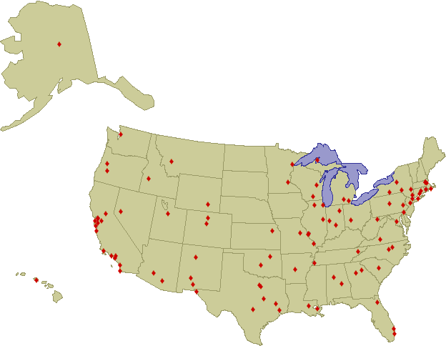
The IRIS Membership
125 Full Member Institutions

Slide 5
IRIS
Incorporated Research Institutions for Seismology
IRIS HQ
Washington DC
Data
Generating
Info
Distribution
Seattle
Albuquerque
San Diego
GSN
DS
Research
Community
San Diego
Albuquerque
PASSCAL
EPO
K-12
Public
Socorro

Slide 6
IRIS
Facilities are open to seismologists worldwide
  Free of charge
  Open Data Policy
Talk to IRIS Staff if you have specific questions

Slide 7
IRIS Data Services
Ingestion
  Real time methods
  Bulk file transfer methods
Archiving and Curation
Distribution

Slide 8
IRIS Data Services - ingestion
Ingestion
  Real time methods rely on BUD
    SeedLink is our preferred method
    Antelope Orb2Orb
    RRP
    CD1.0 and CD1.1
    And a variety of others
  Bulk file transfer methods
    mseed2dmc

Slide 9
IRIS Data Services - ingestion

Slide 10
Archiving and curation

Slide 11
IRIS Data Services - distribution

Slide 12
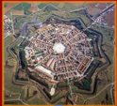
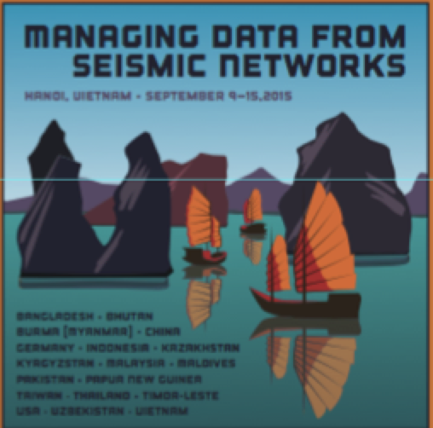

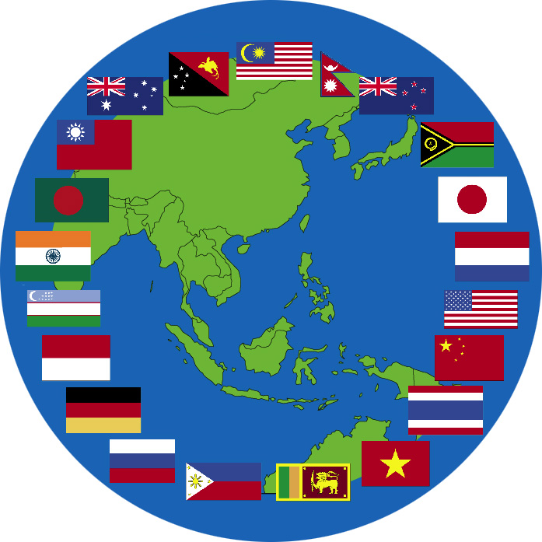
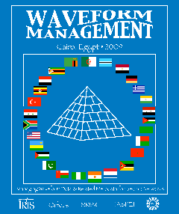
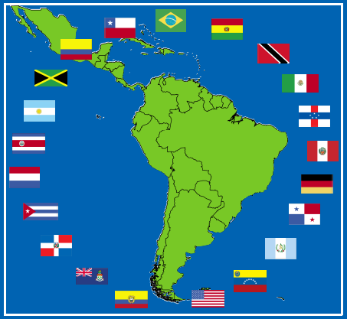
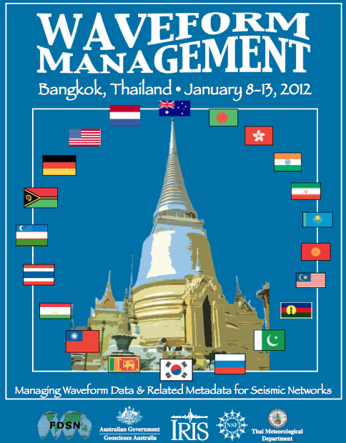
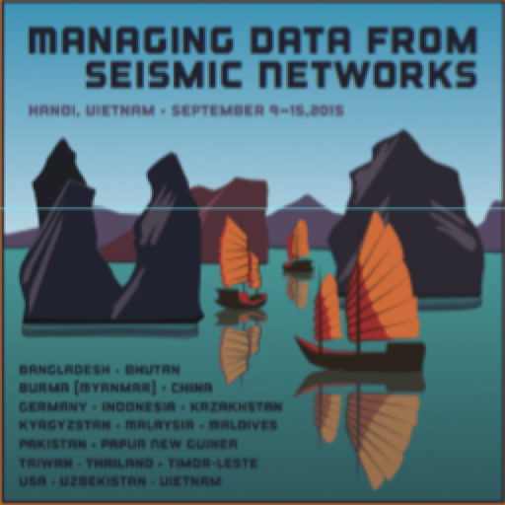
Palmanova
Italy (2005)
Managing Data from Seismic Networks
10th Data Workshop
Palmanova
Italy (2005)
Sao Paulo
Brazil (2006)
Foz do Iguaçu
Brazil
(2010)
Bangkok
Thailand
(2012)
Petaling Jaya
Malaysia (2007)
Giza
Egypt (2009)
Kuwait City
Kuwai
(2013)
Bogota
Colombia (2014)
Hanoi Vietnam (2015)

Slide 13
IRIS DS
International Activities
Data Workshops
  A total of ten workshops
Regional Exchange of Earthquake Data (REED)
Support for SeisComp3
  Included FDSN web services support

Slide 14
Workshops and REED Projects

